Slide 1
Interactive Notebooks for Biologists (Jupyter & Anaconda)
R. Burke Squires
Sept 6, 2018

Slide 2
Jupyter and Anaconda
Introduction
Anaconda
Anaconda distribution overview
Installation Demo
Jupyter
Introduction to Jupyter Ecosystem
JupyterLab and Jupyter Notebook
Writing narrative text
Running code (Python, R, other)
Magic commands
<Lunch>
Sharing Jupyter notebook
Building a bioinformatics workflow
Demos

Slide 3
Jupyter Ecosystem
Today
This Session
Introduction
Anaconda
Anaconda distribution overview
Installation Demo
Jupyter
Introduction to Jupyter Ecosystem
JupyterLab and Jupyter Notebook
Writing narrative text
Running code (Python, R, other)
Magic commands
<Lunch>
Sharing Jupyter notebook
Building a bioinformatics workflow
Demos
Notebooks as the new scientific paper
A short history (Mathematica notebook, IPython, etc.)
Literate programming
Drivers: data science
Benefits of notebooks
Improved collaboration
Jupyter for r and python researchers

Slide 4
Jupyter and Anaconda
Notebooks as the new scientific paper
News about Jupyter notebooks (1 hr. prep)
nature article (?)
other articles
PubMed search for Jupyter articles

Slide 5
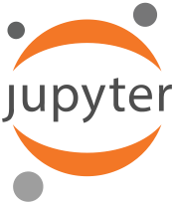
Jupyter Ecosystem
Julia – Python - R
Jupyter notebook
Jupyterlab (IDE)
Jupyterhub (shared notebooks)
Kernels
Ipython
R
Julia
Other

Slide 6
Jupyter Ecosystem
November 2001: "Just an afternoon hack"
259 Line Python script.
Plotting, Numerics, interactive workflow.
Today
> 500 contributors
Multiple GitHub orgs, > 120 repos
Hundreds of thousands of lines of code, multiple languages
At least 4 million users
~ $ 8M in direct funding
~25 full-time developers (academia, industry, non-profits)

Slide 7
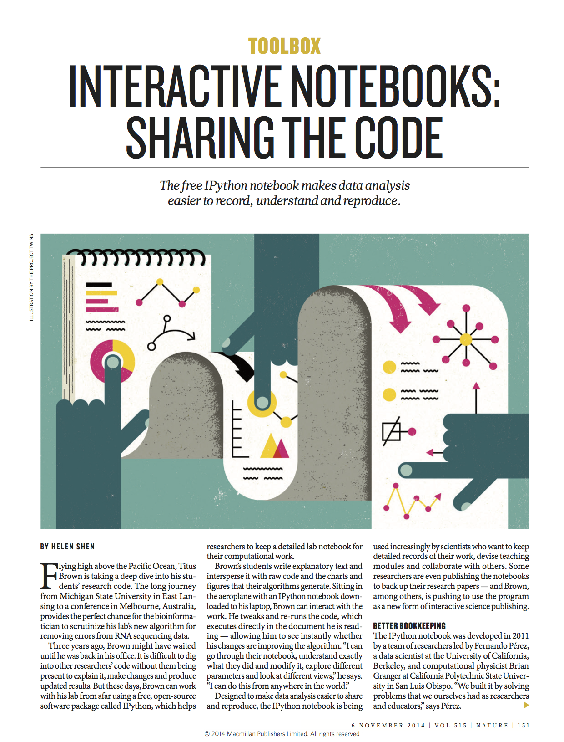
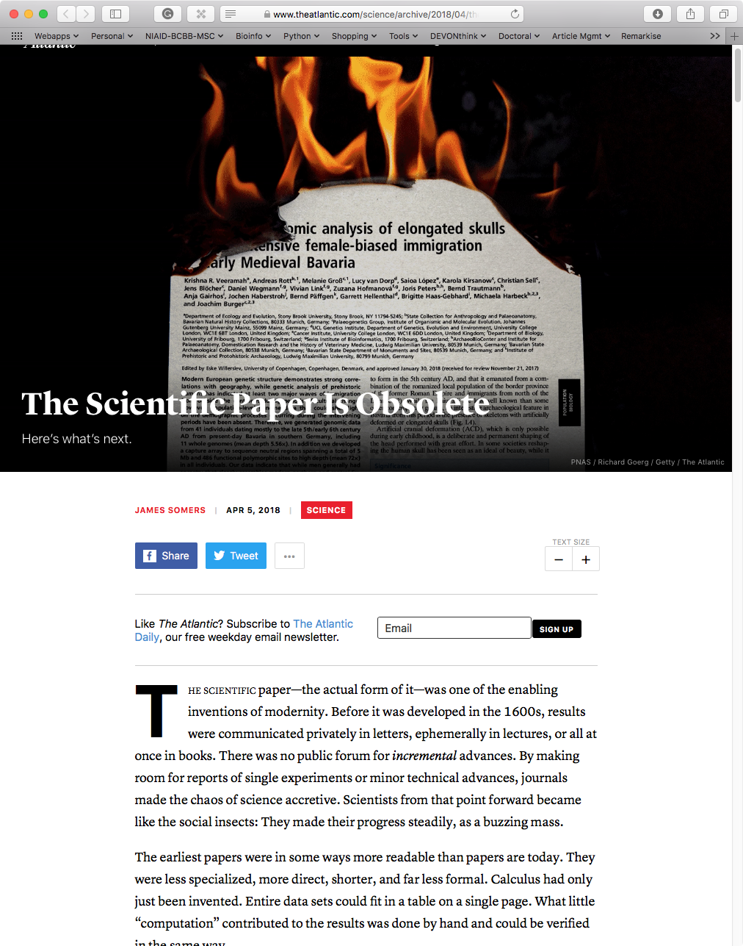

Slide 8
Notebooks: “Literate Computing”
Computational Narratives
Computers deal with code and data. Humans deal with narratives that communicate.
Literate Computing (not Knuth's Literate Programming) narratives anchored in a live computation, that
communicate a story based on data and results. Cf: Mathematica, Maple, MuPad, Sage...

Slide 9
Jupyter Ecosystem
A short history (Mathematica notebook, IPython, etc.)

Slide 10
Jupyter Ecosystem
literate programming (https://biowize.wordpress.com/2015/03/13/literate-programming-rstudio-and-ipython-notebook/)
interactive computing
computing narratives

Slide 11
Jupyter Ecosystem
Drivers: data science

Slide 12
Jupyter Ecosystem
Benefits of notebooks
Improved collaboration
Jupyter for r and python researchers

Slide 13
Projects Incorporating Jupyter Notebooks
Kbase
Galaxy
GenePattern

Slide 14
Anaconda
Anaconda distribution
Additional distribution
Enthought

Slide 15
Notebook Workflow: The Big Picture
https://github.com/jbarratt

Slide 16
What is the notebook?
A "browser-based interactive computing environment"
Why are we talking about it today?
Extremely useful tool, but not well enough known outside Academia/Science.
Makes the (powerful) python data/science/module ecosystem even more powerful
If you code, (even not in python), sysadmin, write documentation, blog, do any analysis or visualization, you might get a lot out of the notebook.
https://github.com/jbarratt

Slide 17
https://github.com/jbarratt

Slide 18
"Literate"
The other attributes will be clear, but a word on Literate (apologies to Knuth for the oversimplification)
This is a big part of where the title comes from: it's about the story more than the software. (Because of inline output, Notebook may even be 'SuperLiterate'.)
Update: IPython's founder, @fperez_org kindly pointed me to a blog post of his; they prefer the term Literate Computing.
https://github.com/jbarratt

